Slide 1
Towards an updated definition of dyslexia: findings from a Delphi study of dyslexia experts
Professor Julia Carroll
Dr Paul Thompson
With thanks to Maggie Snowling, Caroline Holden and Philip Kirby

Slide 2
Plan for the Talk
Background – previous definitions of dyslexia
Why do we need to agree a consensus on dyslexia?
How the Dyslexia Delphi was carried out
What were the thorny issues?
A new definition of dyslexia

Slide 3
1970s-1990s: Dyslexia as a categorical disorder
Specific disorder
Nature and Etiology
IQ-discrepancy definition
  Oral Language proficient
  Good nonverbal ability
Secondary consequences of poor reading
  Attention difficulties
  Behaviour problems
Runs in families
Due to a specific phonological deficit
Direct cause of poor decoding
Persistent across life span
Notes:
At this time, the idea of a PD in dyslexia was gaining ground in the US and by the close of the 1970s the WFN’s definition had been replaced
Dyslexia was now viewed as a specific disorder.
‘specific’ because it was a disorder thought to occur in individuals of average or above average intelligence in which there was a discrepancy between oral and written language skills
If there were other problems, eg attention or conduct, these were thought of as secondary to the reading problem.
It was known to run in families, so likely a genetic etiology associated with a specific PD which was persistent across the life-span despite the fact than many individuals with dyslexia learned to read using compensatory strategies.

Slide 4
2000s: Dyslexia reconsidered
Neurodevelopmental Disorder
Risk Factors
Classified alongside Mathematics Disorder and Writing Disorder as ‘specific learning disorder’
Not a category but a dimensional disorder
Primary [core] phonological deficit
Family risk
  Polygenic etiology
Language difficulties (persistent)
Gene-environment correlations
  Home literacy environment
  Motivation and print exposure
Notes:
Drawing this together, we can now refine our definition and description of dyslexia
In DSM5 classified as a specific learning disorder alongside others MD and WD
But its not a categorical diagnosis rather a dimension or continuum
The primary deficit is in phonology but this can be moderated by other factors, including intervention
We also know more about the risks of dyslexia:
polygenic etiology - >family risk
can be associated with persistent language difficulties
risk factors stack up to lead to ‘diagnosis’
Importantly we are increasingly aware of the importance of gene-environment correlation eg passively through the HLE as a possible causal risk factor for dyslexia; active ge role of motivation to read in determining outcomes.

Slide 5
Why do we need consensus about a definition?
“To the extent that clinical economy depends on getting the right treatment to the right people, clinicians are…categorisers. At a purely practical level this depends on a judgement being made that such and such a child belongs to the category of those who ‘need help’, whereas another child belongs to a (usually) larger category who do not.” (p. 117).
Sonuga-Barke (1998) Categorical models of childhood disorder: a conceptual and empirical analysis. Journal of Child Psychology and Psychiatry, 39, 115-133.

Slide 6
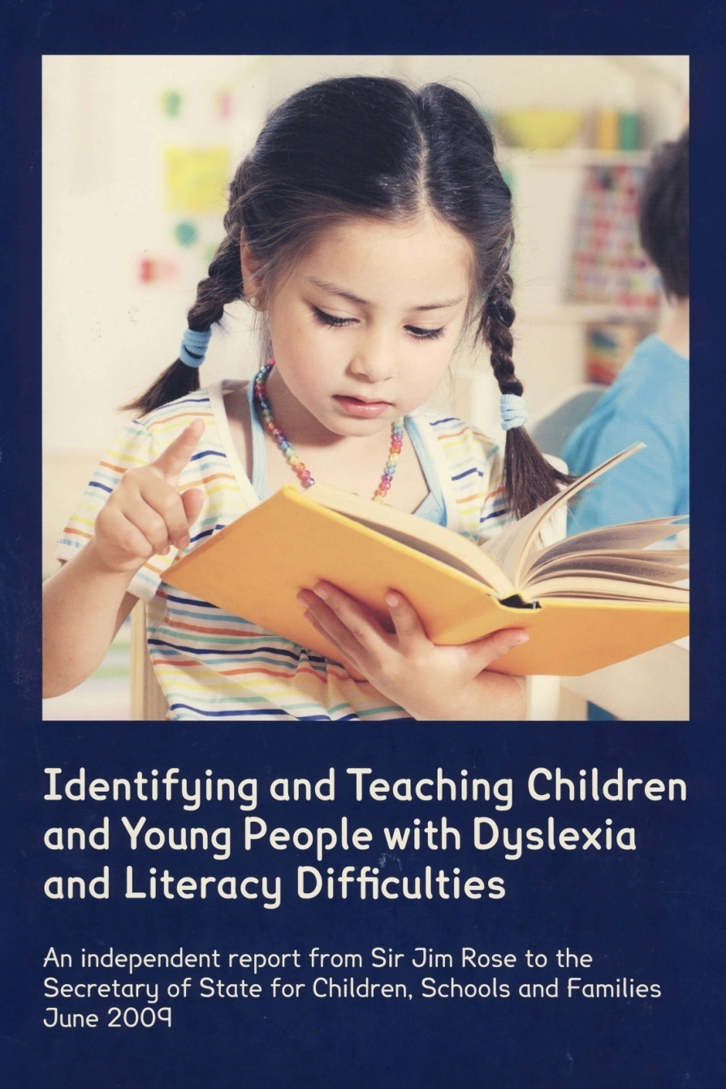
Rose Report (2009)
Dyslexia is a learning difficulty that primarily affects the skills involved in accurate and fluent word reading and spelling.
Characteristic features of dyslexia are difficulties in phonological awareness, verbal memory and verbal processing speed.
Dyslexia occurs across the range of intellectual abilities. It is best thought of as a continuum, not a distinct category, and there are no clear cut-off points.
A good indication of the severity and persistence of dyslexic difficulties can be gained by examining how the individual responds or has responded to well-founded intervention.
‘Co-occurring difficulties may be seen in aspects of language, motor co-ordination, mental calculation, concentration and personal organization, but these are not, by themselves, markers of dyslexia’
Notes:
Finally, if research on learning is to have impact it should affect on educational policy and practice.
To some extent out work has had such influence, in bringing awareness to policy makers of the importance of oral language, on methods of identification and interventions for dyslexia, and in the scaleability of language intervention

Slide 7

International Dyslexia Association
Dyslexia is a specific learning disability that is neurobiological in origin.
It is characterized by difficulties with accurate and/or fluent word recognition and by poor spelling and decoding abilities.
These difficulties typically result from a deficit in the phonological component of language that is often unexpected in relation to other cognitive abilities and the provision of effective classroom instruction.
Secondary consequences may include problems in reading comprehension and reduced reading experience that can impede growth of vocabulary and background knowledge.

Slide 8
Rose versus IDA Definitions
Rose
Issue | Rose | IDA
Mentions accuracy and fluency | Yes | Yes
Mentions co-occurring disorders | Yes | No
Mentions phonological skills | Yes | Yes
Addresses possible causes | ‘how an individual responds to intervention’ | ‘neurobiological in origin’
Role of intellectual abilities | ‘can occur across the range of IQ’ | ‘often unexpected in relation to other cognitive abilities’

Slide 9
Elliott (2020) “it’s time to be scientific about dyslexia”
Contrasts 4 different approaches to defining dyslexia:
  Individuals with poor reading accuracy
  A subgroup of individuals with poor reading accuracy, decided clinically
  Individuals whose reading difficulties do not respond well to intervention
  A complex neurodiverse profile which goes beyond reading difficulties, and in some cases may not include reading difficulties
Argues that all of them are problematic
Notes:
I anticipate that most of you have read some of Professor Elliot’s work, or seen him talk. His thesis is that the definitions of dyslexia used in practice lack scientific validity.
I use the word definitions, rather than definition, because he argues that there are different definitions used by different people and in different situations. A recent paper of his talks about four different types of definition of dyslexia.
The first is purely based on low reading accuracy. All individuals with poor reading accuracy are dyslexic. This is straightforward, but would not require detailed diagnostic assessment
The second is a clinical definition. Poor reading accuracy is a necessary characteristic, but we should also look at other skills and patterns of strengths and weaknesses. This requires diagnostic assessment
The third is around responsiveness to intervention. Several individuals have proposed taking this approach, of focusing diagnosis only on children who do not respond well to good quality intervention.
The final one is more complex, and goes beyond reading difficulties, and in fact in some cases individuals may not have reading difficulties any more.
I think that elements of each of these definitions will be familiar to most of us. I am not going to give my views too much on these different definitions, but just to highlight that Elliott argues that they are all problematic in one way or another.

Slide 10
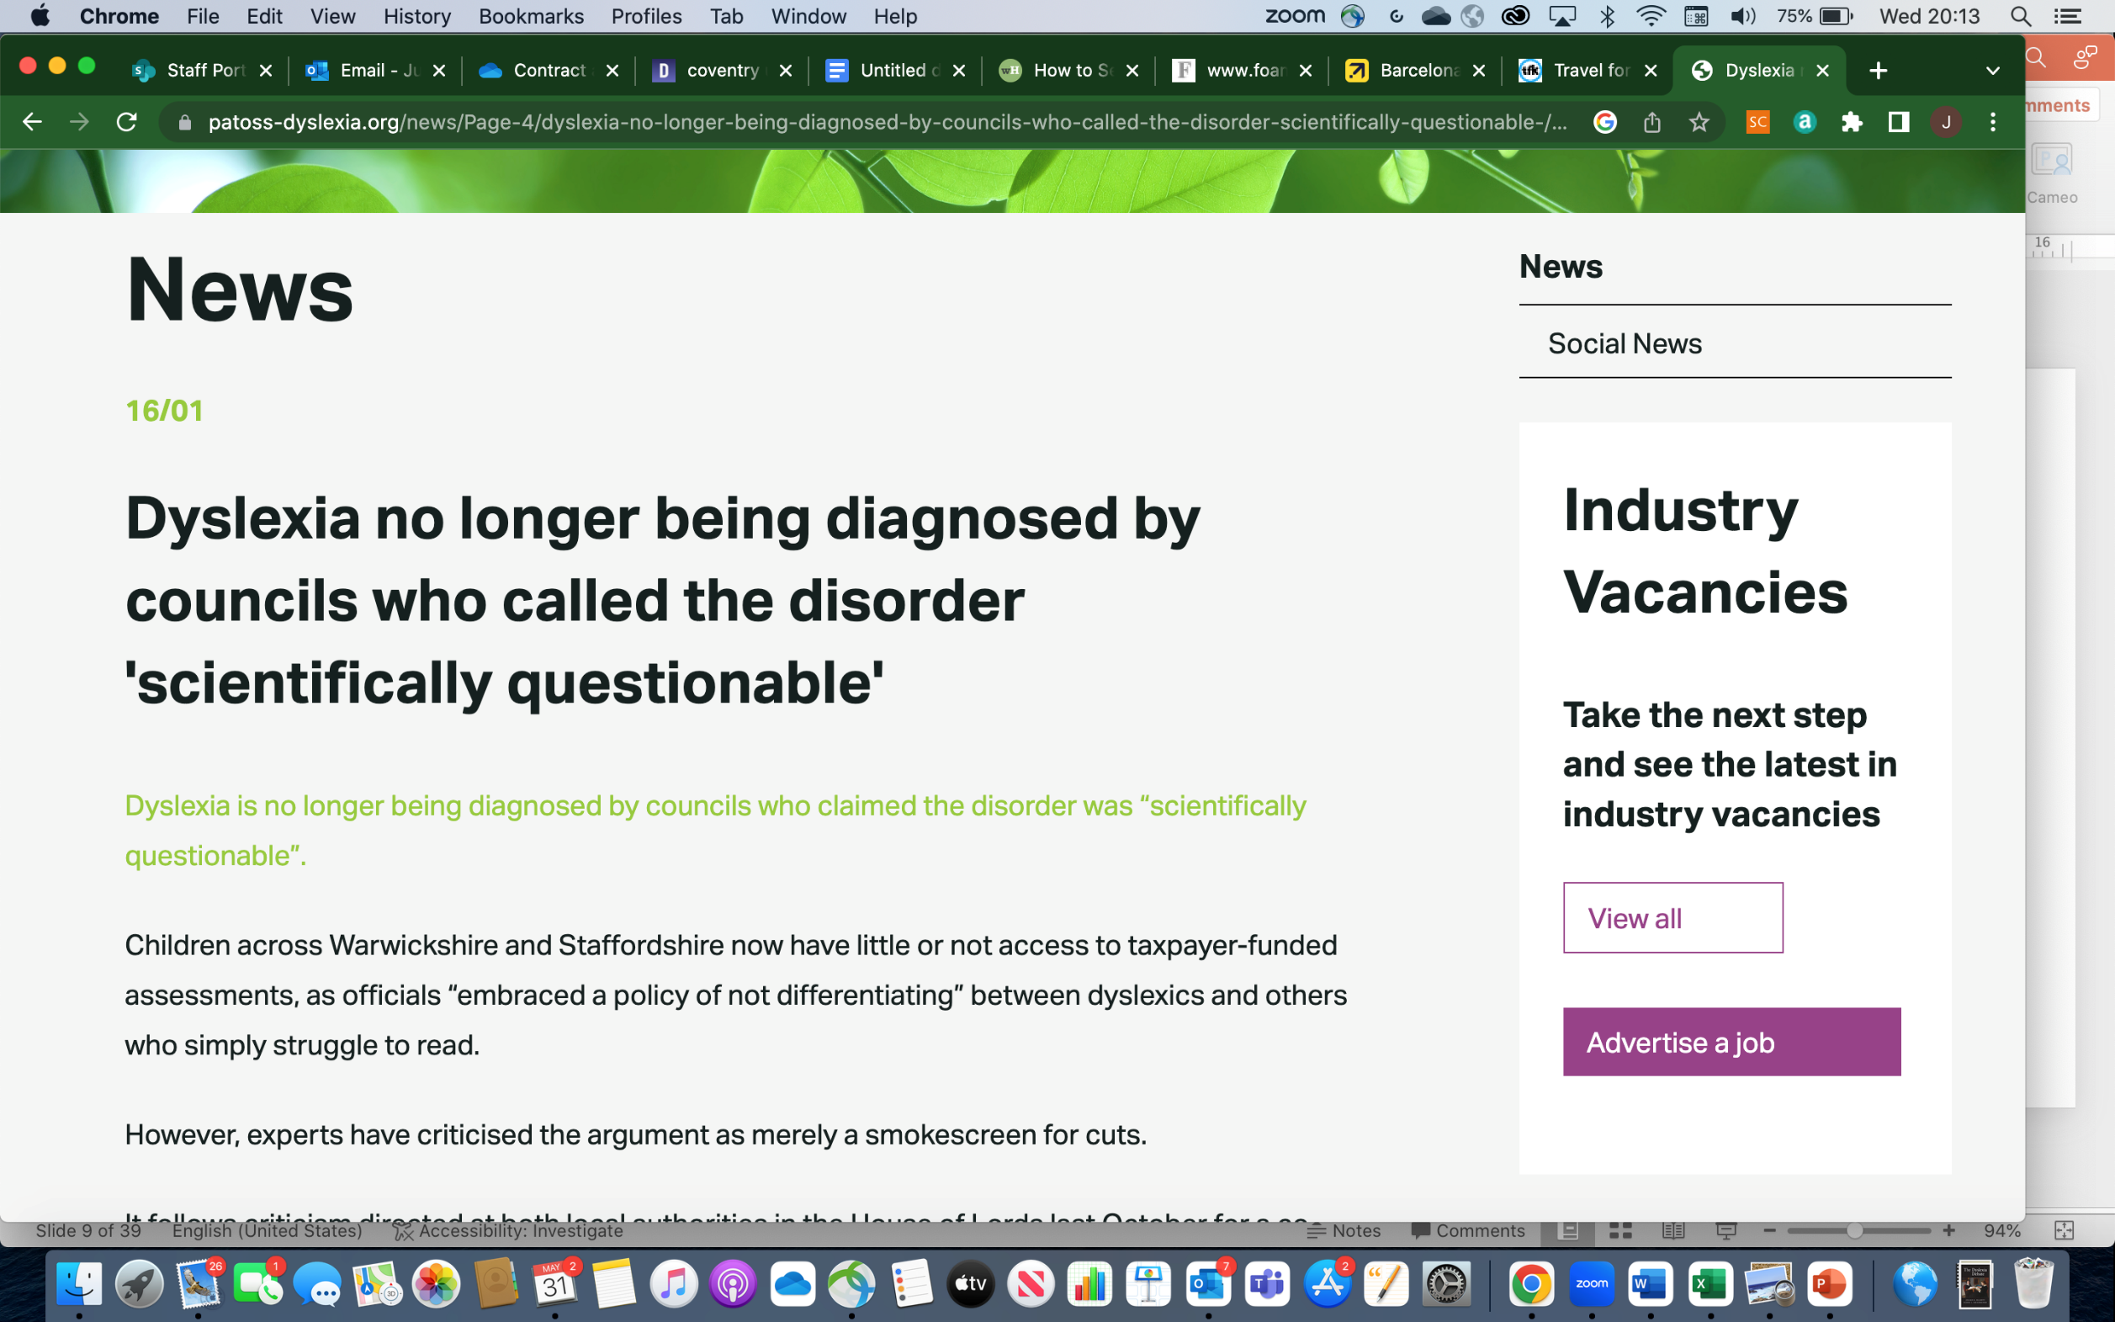
2019: Local authorities discouraging diagnosis of dyslexia
Warwickshire and Staffordshire argue that if dyslexia is just reading difficulties, diagnosis is unnecessary
Focus instead on early reading support for all
Many parents respond by seeking private assessment and battling for additional support
Notes:
Elliot’s arguments have not fallen on deaf ears. In fact, several local authorities have chosen to reduce or avoid diagnosis of dyslexia. Some have done this explicitly, as with Warwickshire and Staffordshire. Others have done this more implicitly – I have heard that Cambridgeshire and Surrey also do not diagnose dyslexia as a matter of course.
The justification for this is that schools know how to support reading difficulties, and they should be providing reading support for all, whether or not they have a diagnosis
Note that this hasn’t generally been well received. Many parents have responded by seeking private assessment, or by going to the media. Clearly people still feel that a diagnosis is useful, even if reading support is being provided.

Slide 11
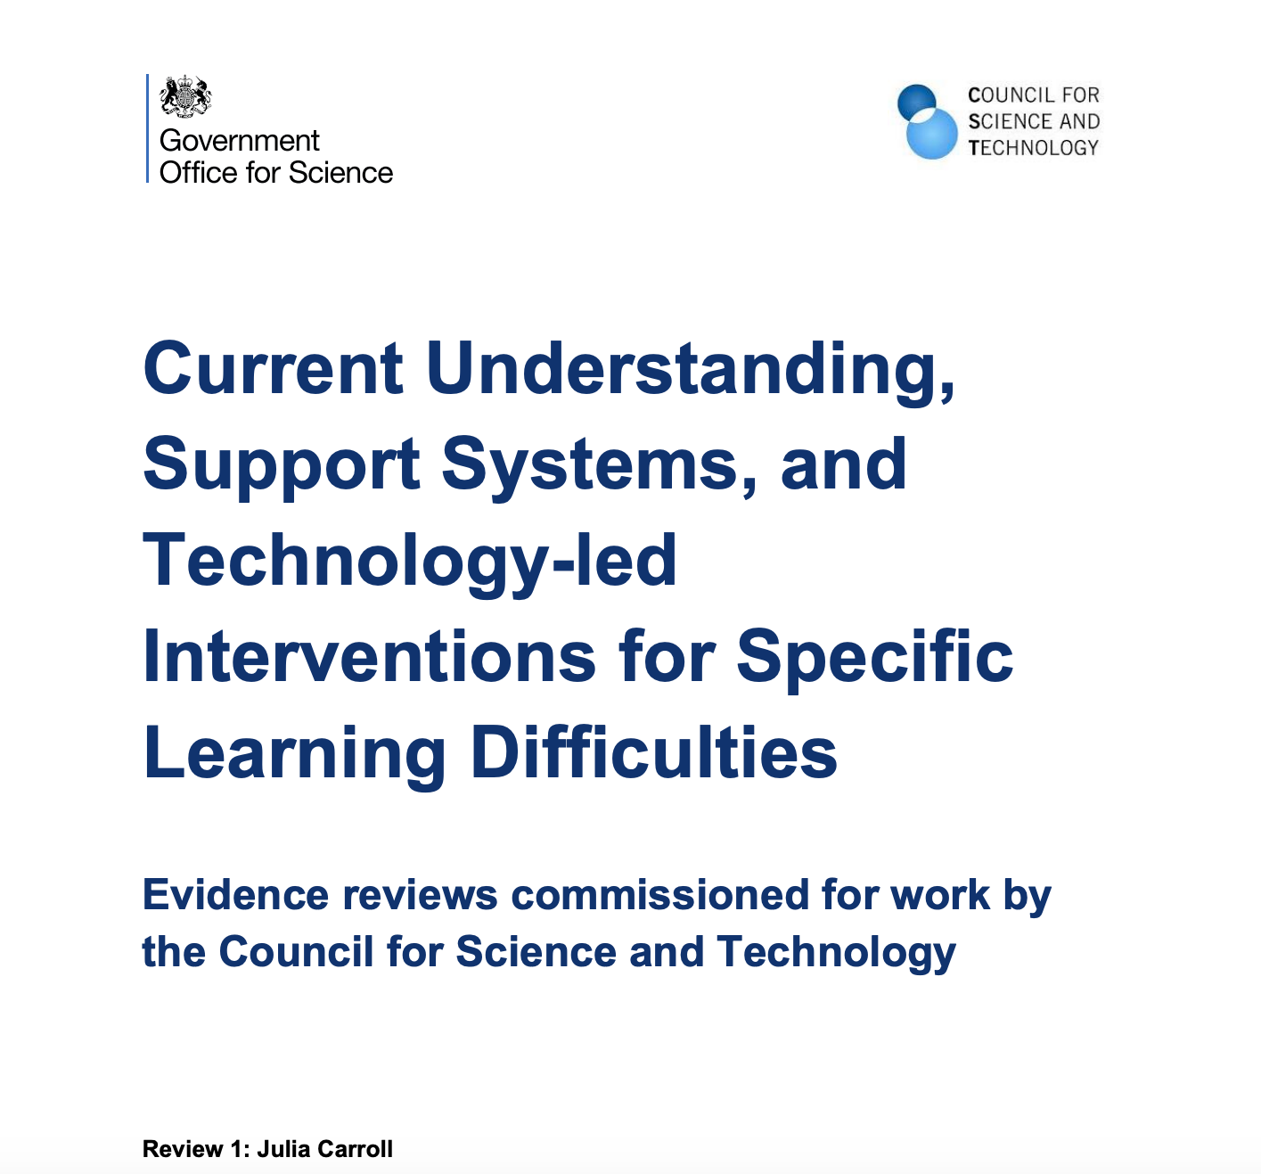
2020 Review of SpLD: current issues
Lack of consistency over time – different expectations/requirements for diagnosis in school/college/university/work
Differences in diagnostic criteria used in research and practice
Lack of clarity of the roles of specialist teachers and educational psychologists
All feed into confusion for individuals, parents and teachers
Notes:
In 2020 I was asked to write a review of current issues with regard to specific learning difficulties
Some of the issues I raised were around the lack of consistency over time – there are different expectations and requirements for diagnosis in school, in college and in work.
Differences in diagnostic criteria in research and in practice – that aligns with Joe Elliot’s point
Lack of clarity of the roles of different professionals
Creates a confusing position for everyone

Slide 12
2021 – 2023: SASC Review
Initiated in January 2021
A review of assessment and identification of dyslexia
Four phases:
  Working Group
  Consultation Phase 1
  Publication of a paper: Specific Learning Difficulties (SpLD) Assessment Standards Committee (SASC) Consultation Paper on the identification of and effective intervention for literacy difficulties in children and adults. Implications for the assessment of dyslexia.
  Responses to the paper were gathered (407 responses)
  Issues arising were discussed with practitioners in structured meetings. Summaries of these meetings were presented to the SASC Board in January 2023.
Notes:
In this context, SASC decided to hold a review of assessment and identification of dyslexia. This was a detailed and in depth review. It had four phases. This led to a paper and a series of statements about dyslexia.
At the same time, the BPS decided to hold two reviews about assessment for specific learning difficulties. These are still ongoing.
So clearly there is an appetite for improving clarity and consensus in the dyslexia community.

Slide 13
How can we build a consensus?
Assemble a group of experts and use the Delphi method to have an online discussion
Key feature of Delphi: everyone rates and comments on initial set of statements, and sees everyone else’s responses, but whole process is anonymous.
Delphi Method used to build consensus regarding a new or controversial issue

Slide 14
Delphi Dyslexia Team
Investigators: Maggie Snowling, Julia Carroll, Philip Kirby, Paul Thompson, Lynn Greenwold, and Caroline Holden
Moderators: Maggie Snowling, Julia Carroll, Philip Kirby, Caroline Holden
Data controller: Paul Thompson
Admin support: Amy Birtwhistle
Notes:
We have drawn together a team across different backgrounds to carry out this work.
Maggie, myself, Caroline Holden and Philip Kirby will be moderators, meaning that we will review the responses

Slide 15
Expert Panel Members
Professionals: psychologists, clinical, educational, occupational, other
Assessment practitioners: specialist assessors, specialist teacher- assessors, access arrangements assessors
Specialist teachers, SENCOs, support service managers in LAs, schools, colleges and HE
Families and people with ‘dyslexia’
Stakeholding organisations and CPD/ psychology or specialist teacher training providers, e.g. BDA, Helen Arkell Centre, PATOSS, Dyslexia Guild, Real Training, IOE
Academics/researchers
UK Devolved Nations
  England, Scotland, Northern Ireland, Wales
Europe
US and International
Selected ‘experts from a longlist taking account of EDI considerations
Additional panel members from under-represented categories
Survey 1 sent to 71 ‘experts’.
Notes:
We have tried to actively select people from a wide range of backgrounds, with high levels of expertise.
We have tried to include people who have taken part in the reviews by SASC and BPS
We have included professionals, including specialist teachers, psychologists, people working with children and adults
We have included academics from different backgrounds
We have families and people who have lived experience of dyslexia
We have representatives from stakeholder organisations

Slide 16
Demographics of the Panel
What country do you live in?
  England (73%)
  Scotland (9%)
  Wales (2%)
  Northern Ireland (2%)
  USA (2%)
  Europe (7%)
  Other (5%)
Gender: 69% female, 31% male
Ethnicity: 82% white
Profession:
  44% Academic
  9% Educational Psychologist
  27% Specialist teacher and/or assessor
  20% Other
Notes:
We have representation from all four countries of the UK, but you can see that the largest group is from England
We have tried to include a good balance of males and females, and currently the sample is 69% female
Sample is 82% white, with a mix of other ethnicities
In terms of profession, just over 40% are academics, 27% are specialist teachers or assessors, 9% are educational psychologists, 20% ‘other’ – we haven’t yet viewed what this includes, but will include stakeholder organisations and individuals with dyslexia

Slide 17
The Process
SASC Review
The Science of Reading
62 Candidate Statements
Reviewed by moderators
55 Round 1 Statements
The Dyslexia Debate
Expert panel rates statements and comments on them
27 statements accepted,
22 statements reworded for Round 2
Feedback to panel
Reviewed by moderators
Expert panel rates statements and comments on them
Feedback to panel
Reviewed by moderators
List of agreed statements

Slide 18
Example Statement
“Persistent and sometimes severe difficulties in word and non-word decoding (reading accuracy) are typically observed in children with dyslexia.”
Strongly agree
Somewhat agree
Neither agree nor disagree
Somewhat disagree
Strongly disagree
Don’t know/ no opinion
If you have additional comments on this statement, please add them here:
Notes:
This allows us to assess the ratings and select statements which have cconsistent agreement, but also to understand why some statements don’t have agreement, to allow us to modify them in the next round.

Slide 19
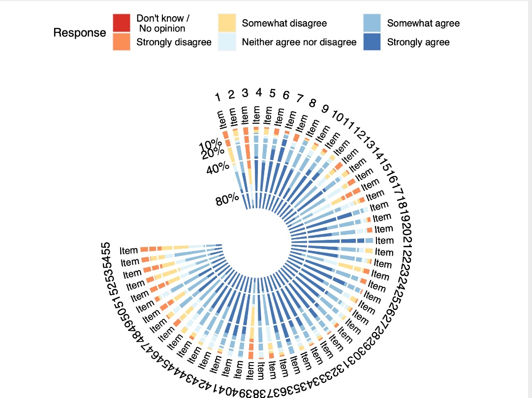
Round 1 Results
Review process
  27 had agreement ratings of >85%
    Accepted (sometimes with minor rewording)
  14 had agreement ratings of <60%
    7 were dropped
    7 were significantly reworded (one was flipped)
  14 had agreement ratings of between 60 and 85
    Significantly reworded
  3 ‘consensus statements’ added

Slide 20
Round 2 Results
Review Process
  14 out of 22 had agreement >80% - accepted
  4 had agreement between 75 and 84 – discussed in a sub-panel
  4 had agreement below 75 – they are dropped

Slide 21
Where do we agree?
The Nature of Dyslexia
  Dyslexia is primarily a set of processing difficulties that affect aspects of literacy attainment, despite the educational opportunity to learn to read and spell.
  Persistent and sometimes severe difficulties in word and non-word decoding (reading accuracy) are typically observed in children with dyslexia.
  Secondary consequences of dyslexia may include problems in reading comprehension and reduced reading experience that can impede growth of vocabulary and background knowledge.
  Dyslexia frequently co-occurs with one or more other developmental difficulties, including developmental language disorder, ADHD, developmental coordination disorder, and dyscalculia.

Slide 22
Agreement - Initial Identification
All individuals struggling with literacy require appropriately targeted intervention, resources and monitoring.
In the early years of reading instruction, the identification of needs of children with literacy learning difficulties should be prioritised over detailed diagnostic assessment. Detailed diagnostic assessment should not be a precondition for putting intervention in place.
Individuals with reading difficulties should be referred for specialist assessment if there is consistent lack of progress in reading or writing despite targeted assistance.
The following features may be indicative of dyslexia in the early years: (a) a family history of dyslexia; (b) slow acquisition of letter names and/or sounds; (c) difficulty blending and segmenting sounds; (d) slow naming speed; (e) particular difficulty reading nonwords, and non-phonetic spelling errors.

Slide 23
Agreement - What to Assess
Assessment of dyslexia can be for many different purposes and the content of the assessment needs to be aligned to purpose
Good assessment and intervention practice embodies a hypothesis-testing approach. Assessors should ask themselves what risk factors are at play, including risk of a longer-term difficulty.
Assessing phonological processing and orthographic skills is important for identifying the impact of dyslexia on the individual concerned and to inform intervention
Working memory and processing speed problems can contribute to the impact of dyslexia and therefore should be assessed.

Slide 24
What were the thorny issues?
Setting specific cut-off points
The role of IQ and intelligence testing
What should be in a screening measure?
Is dyslexia the extreme of a continuum of reading and spelling skill?
Involvement of sensory or motor deficits

Slide 25
Issue 1: guidance and setting specific cut-off points
“In the identification of dyslexia in children, cut-off criteria, e.g. scores of at least 1SD below the mean for age in one or more standardised tests of literacy skill, are important in establishing evidence for the persisting difficulties characteristic of dyslexia. They provide guidance and prevent over-identification.” (65% agreement)
“Guidelines are needed so that assessments for dyslexia are consistent; specific criteria for determining dyslexia are difficult to define and can be expected to vary according to educational context and developmental history.” (75% agreement)
“Guidelines are needed so that assessments for dyslexia are consistent, but it is difficult to achieve consensus on criteria within these guidelines.”

Slide 26
Issue 2: The role of IQ and intelligence testing
“Discrepancy between intellectual ability and literacy attainment is a useful indicator of a specific learning difficulty but is not sufficient for a diagnosis in and of itself.” (79% agreement)
“When an individual has generalised learning difficulties, applying a dyslexia label may result in too narrow an approach to intervention.” (80% agreement)
“Dyslexia can be present in an individual regardless of additional problems (e.g. difficulties with vision or hearing) but the label should not be used in the presence of intellectual disability or where low levels of attainment can be attributed to lack of exposure to literacy” (65% agreement)
Notes:
Issues raised about the discrepancy definition ranged from people rejecting it completely to people feeling uncomfortable diagnosing dyslexia when there is generally low abilities. People felt more clarity was needed and that perhaps the rose review inadvertently suggested that IQ was irrelevant in dyslexia.
“I do a lot of work with highly skilled, professional adults, They can be performing in the average range for literacy but with extra time and other adjustments, they are able to demonstrate a higher level of performance. Many of the adults I see have worked extra hard to get where they are, and many are the first in their family to have reached their level of educational attainment. They have often reached a stage in their lives when they have a greater level of commitments and they can't pull out all the stops to get through their professional exams, as they could when they were at University. I'm very concerned that these people who would suffer if a dyslexia definition rejects any comparison between potential and actual performance”
“My teaching experience…confirmed the importance of ensuring that curriculum design is tailored to the needs of children, informed by the baseline presented, and the importance of developing all skills at compatible levels to ensure that there is not the assumption that one or more of the skills required to learn to read effectively, will develop implicitly or at a later stage.”

Slide 27
A new definition of dyslexia
Dyslexia is primarily a set of processing difficulties that affect the acquisition of reading and spelling.
In dyslexia, some or all aspects of literacy attainment are weak in relation to age, standard teaching and instruction, and level of other attainments.
Across languages and age groups, difficulties in reading and spelling fluency are a key marker of dyslexia.
The nature and developmental trajectory of dyslexia depends on multiple genetic and environmental influences.
Dyslexic difficulties exist on a continuum and can be experienced to various degrees of severity.
Dyslexia can affect the acquisition of other skills, such as mathematics, reading comprehension or learning another language.
The most commonly observed cognitive impairment in dyslexia is a difficulty in phonological processing (i.e. in phonological awareness, phonemic decoding skill or phonological memory). However, phonological difficulties do not fully explain the variability that is observed.
Working memory, orthographic skills and processing speed problems can contribute to the impact of dyslexia and therefore should be assessed.
Dyslexia frequently co-occurs with one or more other developmental difficulty, including developmental language disorder, dyscalculia, ADHD, and developmental coordination disorder.

Slide 28
So What – how does this differ?
Dyslexia is about the processing difficulties, not the attainment itself
A key role for fluency
  Makes the definition less Anglo-centric and less focused on children
The important role of phonological processing is highlighted, but multiple causes and deficits are acknowledged
  A focus on phonological processing only is not appropriate
  Less emphasis on ‘neuro-biological origins’ and more on development over time
Co-occurring difficulties and secondary consequences are highlighted
Implications for assessments are discussed in our companion paper
“The diagnosis must be holistic and not just depend on intellectual ability and literacy attainment”

Slide 29
What Next?
Our submitted papers are currently available on the Open Science Framework:
Paper 1: Definition of dyslexia: https://osf.io/preprints/osf/tb8mp
Paper 2: Assessment of dyslexia: https://osf.io/preprints/edarxiv/g7m8n

Slide 30
Take Home Messages
Divisions and disagreements in defining dyslexia cause problems and confusion for people with dyslexia and professionals supporting them
In order to put research into practice, and to implement interventions, policy makers need to hear ‘one voice’
We can achieve consensus between researchers, teachers and psychologists across several issues
Recent research and views of experienced practitioners can help us refine the definition of dyslexia to make it more useful

